Slide 1

BANK MANAGEMENT SYSTEM PROJECT
Bank Management System in C
Submitted by-
Sunny Jaiswal (1262253496)
Rehan Adatiya (1262253083)
Shravani Kakade (1262252016)
Sayali Mahabaleshwarkar (1262252164)
Parakramank (1262253536)

Slide 2

Introduction
The Bank Management System is a console-based simulation program designed to mimic real-world banking operations. Developed using the C programming language, this project aims to provide hands-on experience with fundamental programming concepts such as structures, arrays, and functions. It offers insights into how banking transactions are processed while maintaining a clear and organized structure for user accounts.

Slide 3
Objectives
Learning
Implementation
Transactions
Understand essential C programming concepts utilized in the bank management simulation project effectively.
Implement data structures and functions to create a functional console-based banking application using C.
Handle banking transactions smoothly, ensuring accurate record-keeping and user-friendly interactions within the program.

Slide 4
Technologies
01
Programming Language
02
Development Environment
The project is developed using C language, emphasizing its efficiency and control over system resources.
Utilized VS Code as the integrated development environment, providing powerful features and tools for code editing and debugging.

Slide 5
Libraries and Functions Used
Libraries Used:
• stdio.h – Input and Outputoperations
• stdlib.h – Memory allocation andsystem functions
• string.h – String handling functions
• conio.h – Console input/outputfunctions
Key Functions Implemented:
• createAccount()
• depositMoney()
• withdrawMoney()
• checkBalance()
• transactionHistory()
• takeLoan()
• payEMI()
• adminLogin()
• lockAccount()

Slide 6
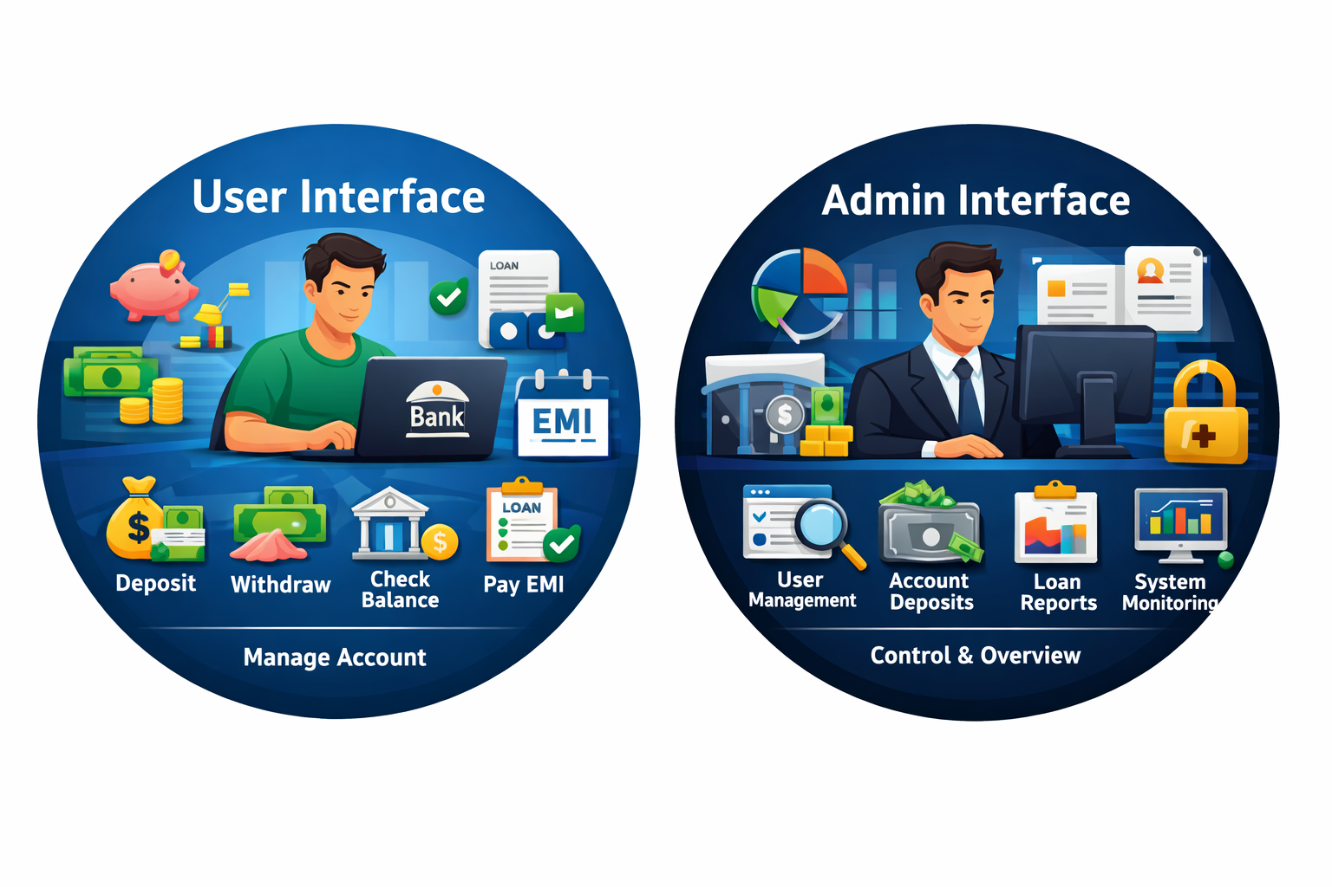
Core Functionalities
The Bank Management System implements several key functionalities that enhance user experience and operational efficiency. Users can create new bank accounts, deposit and withdraw money, check account balances, and view detailed transaction histories, take loans, pay Emi. These features are designed to provide a comprehensive simulation of real-world banking operations, enabling users to practice and understand essential financial processes effectively.

Slide 7
System Design – Bank Management System
1. Overall Architecture:​
Main Menu →User/Admin →Dashboard →Operations​
​
2. Module Design:​
• User Module(Withdraw, Loan, EMI,History)​
• Admin Module (View,Deposit, Reports,Register)​
• Utility Functions(findUser,addTransaction)​
​
3. Security Design:​
• PasswordAuthentication​
• Wrong Attempts →Account Lock​
4. Data StructureDesign:​
struct Account:​
• accNo, name,password​
• balance, loanAmount,emi​
• loanActive, locked​
• transactions,transCount​
​
5. Loan & EMI Logic:​
• Loan ≤ 2 × Balance​
• EMI = (Loan/10) + 5%Interest​

Slide 8
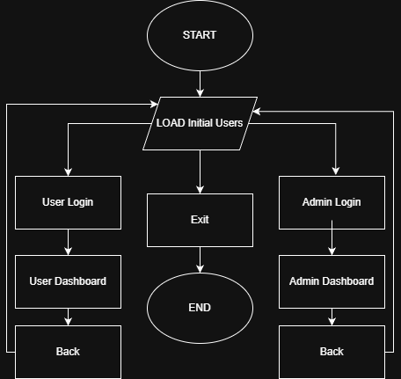
Program Flow
01
Display Menu
The program first displays a menu with options for users to choose from, guiding their actions.
02
User Input
It then takes user input to select an option, ensuring the program responds accordingly to each choice.

Slide 9
Important Functions
Find Account
Deposit
withdraw
Loan Application
Allows users to request loans based on eligibility (Loan ≤ 2× account balance)
This function searches for an account using the unique account number provided by the user.
The deposit function increases the account balance after validating the transaction details provided.
This function allow user to withdraw money while ensuring sufficient balance is maintained or not.
EMI Payment
Deducts EMI from account balance and updates remaining loan amount.
Admin Authentication Provides secure access to administrative operations using admin credentials.
Transaction History Stores and displays all user transactions including deposits, withdrawals, and loan activities.
Account Lock System
Locks the account automatically after 3 incorrect password attempts to enhance security.

Slide 10

Advantages
1. Secure Authentication System
Implements password-based login with automatic account locking after 3 incorrect attempts.
2.Separate Admin Control
Provides dedicated admin panel for monitoring accounts and managing deposits.
3. Loan & EMI Management
Supports loan approval, EMI calculation, and repayment simulation similar to real banking systems.
4.. Structured Programming Approach
Uses structures, arrays, and modular functions for organized and maintainable code.

Slide 11

Future Enhancements
In future, the Bank Management System can be enhanced by implementing file handling to ensure permanent data storage instead of temporary memory usage. The system can also be integrated with a database such as MySQL to support large-scale data management and improve scalability. A graphical user interface (GUI) can be developed to make the application more user-friendly and interactive. Additional features like secure fund transfer between accounts and automatic interest calculation for savings and loans can be incorporated to make the system more realistic. Furthermore, advanced security measures such as password encryption, OTP verification, and role-based access control can be implemented to enhance data protection and system reliability.

Slide 12

Conclusion and Closing Remarks
In summary, the Bank Management System in C successfully showcases practical coding skills while emphasizing transaction handling and account management, paving the way for future enhancements.

